Slide 1

Top 6 Sorting Algorithms in JavaScript

Slide 2
Bubble Sort Algorithm
Selection Sort Algorithm
Merge Sorting Algorithm
Quick Sort Algorithm
Insertion Sort Algorithm
Heap Sort Algorithm

Slide 3
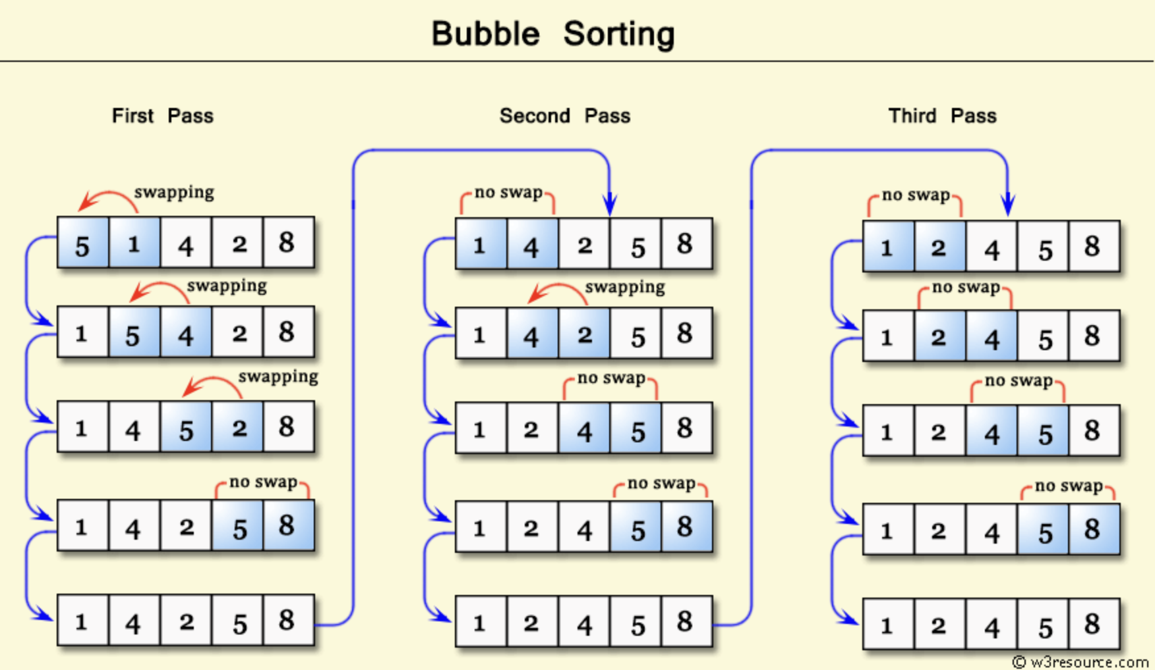
1. Bubble Sort Algorithm

Slide 4
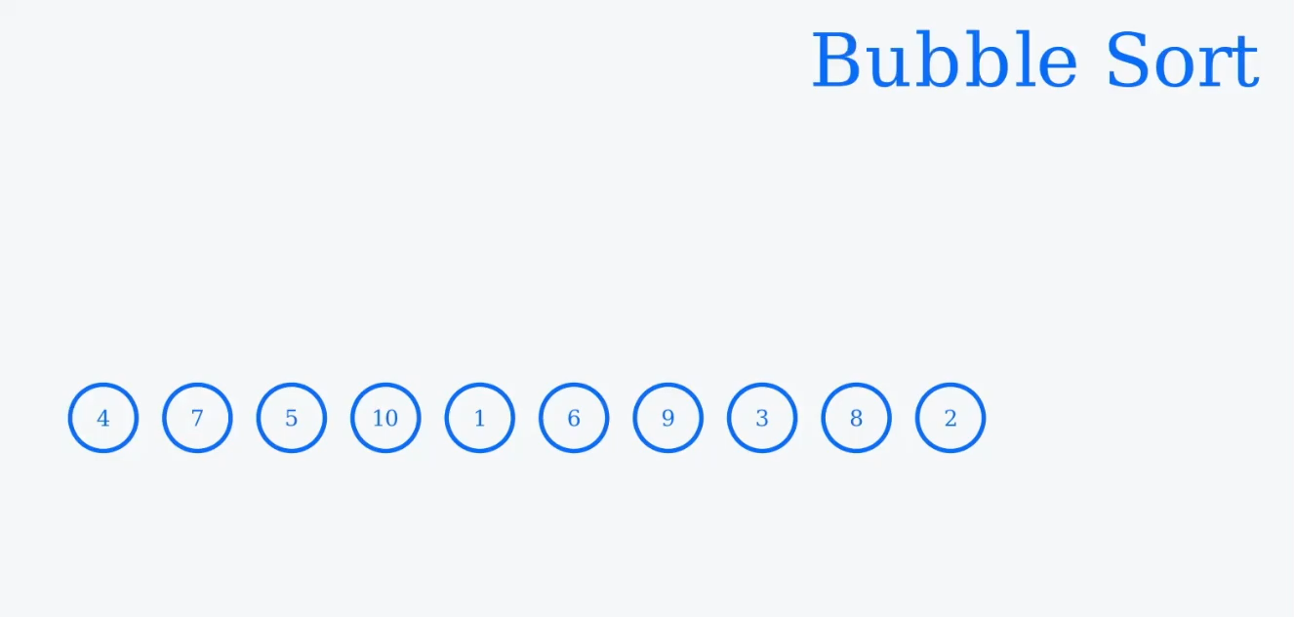
link

Slide 5
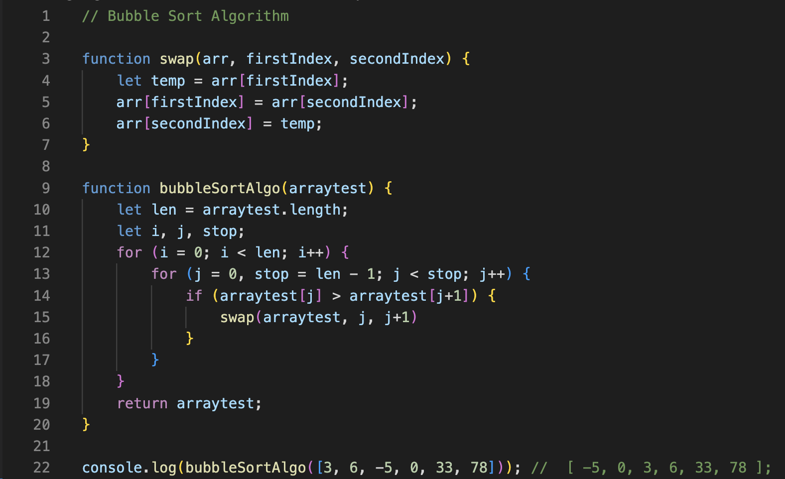

Slide 6
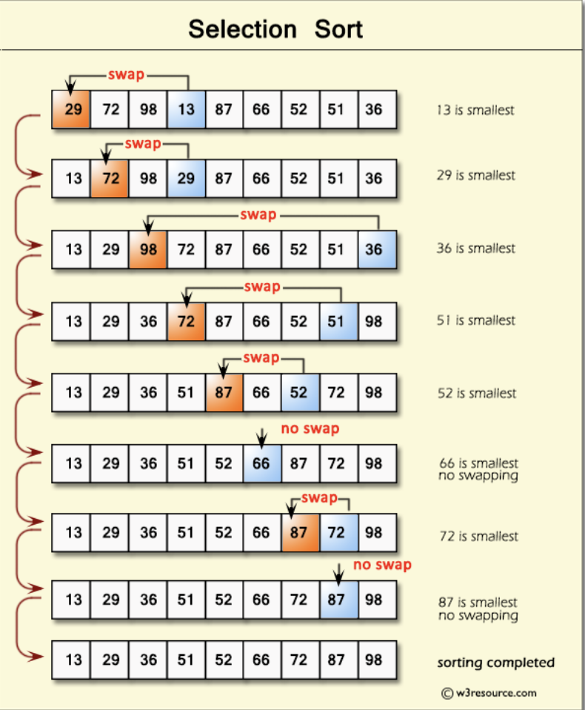
2. Selection Sort Algorithm

Slide 7
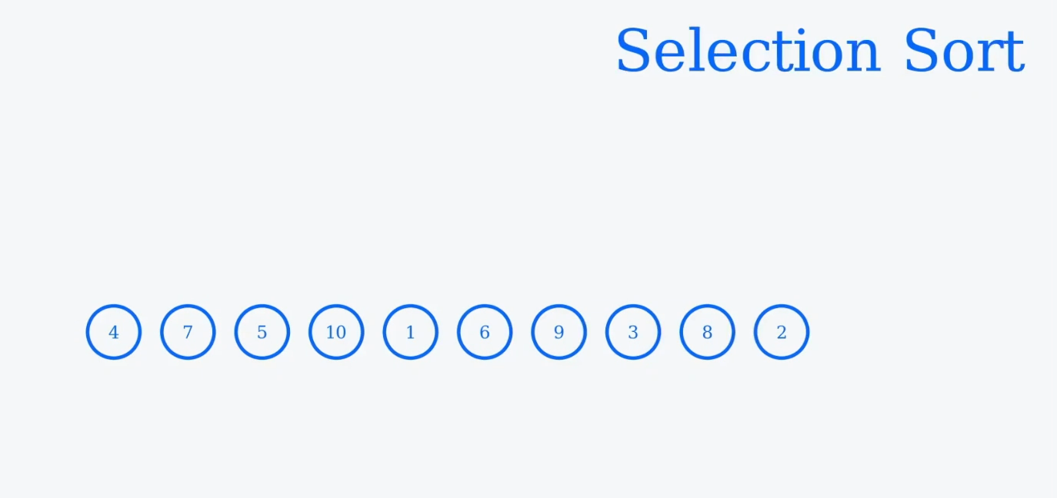
link

Slide 8
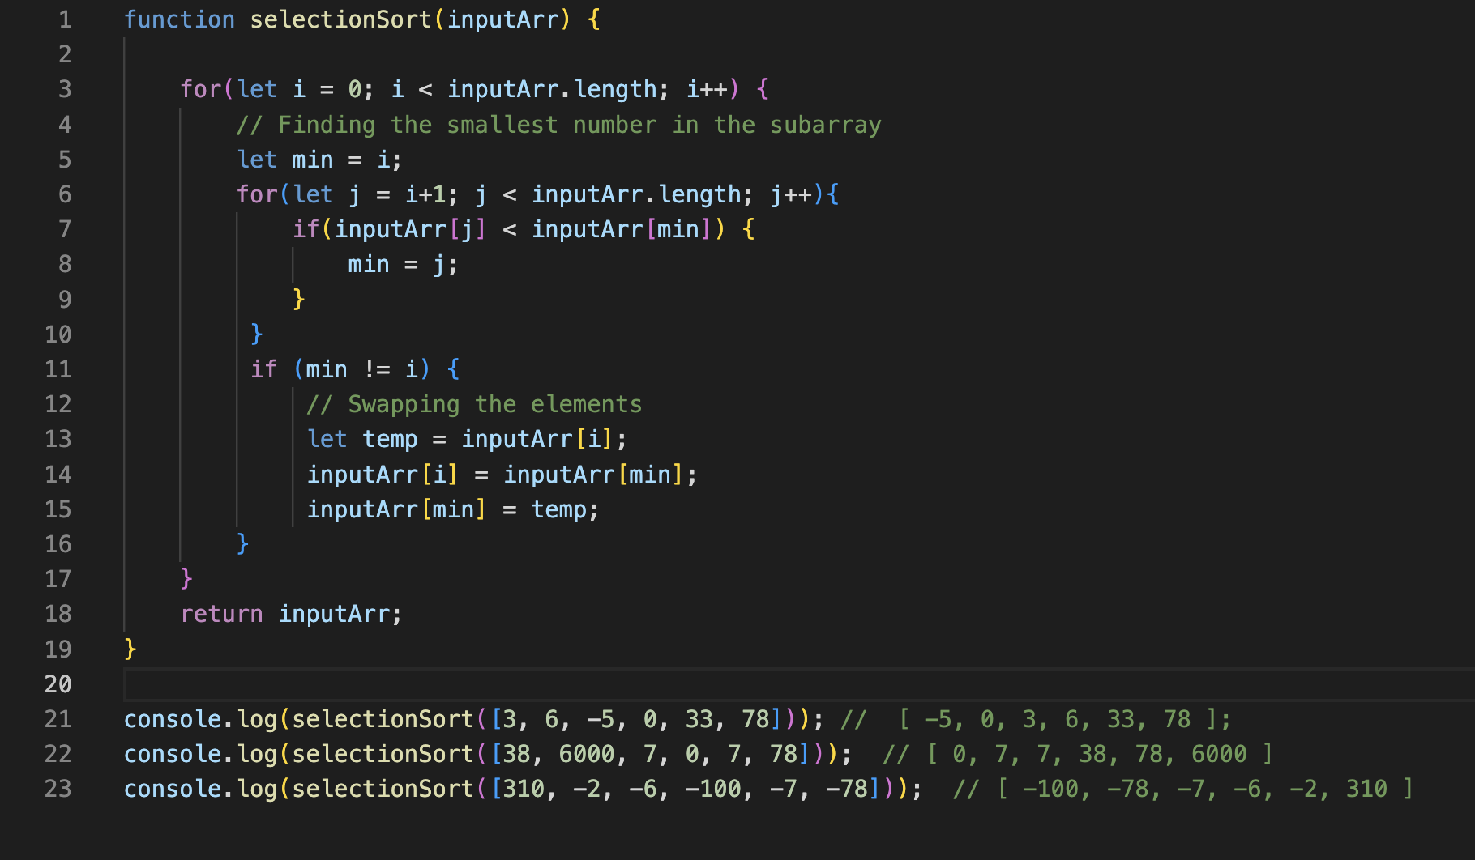

Slide 9
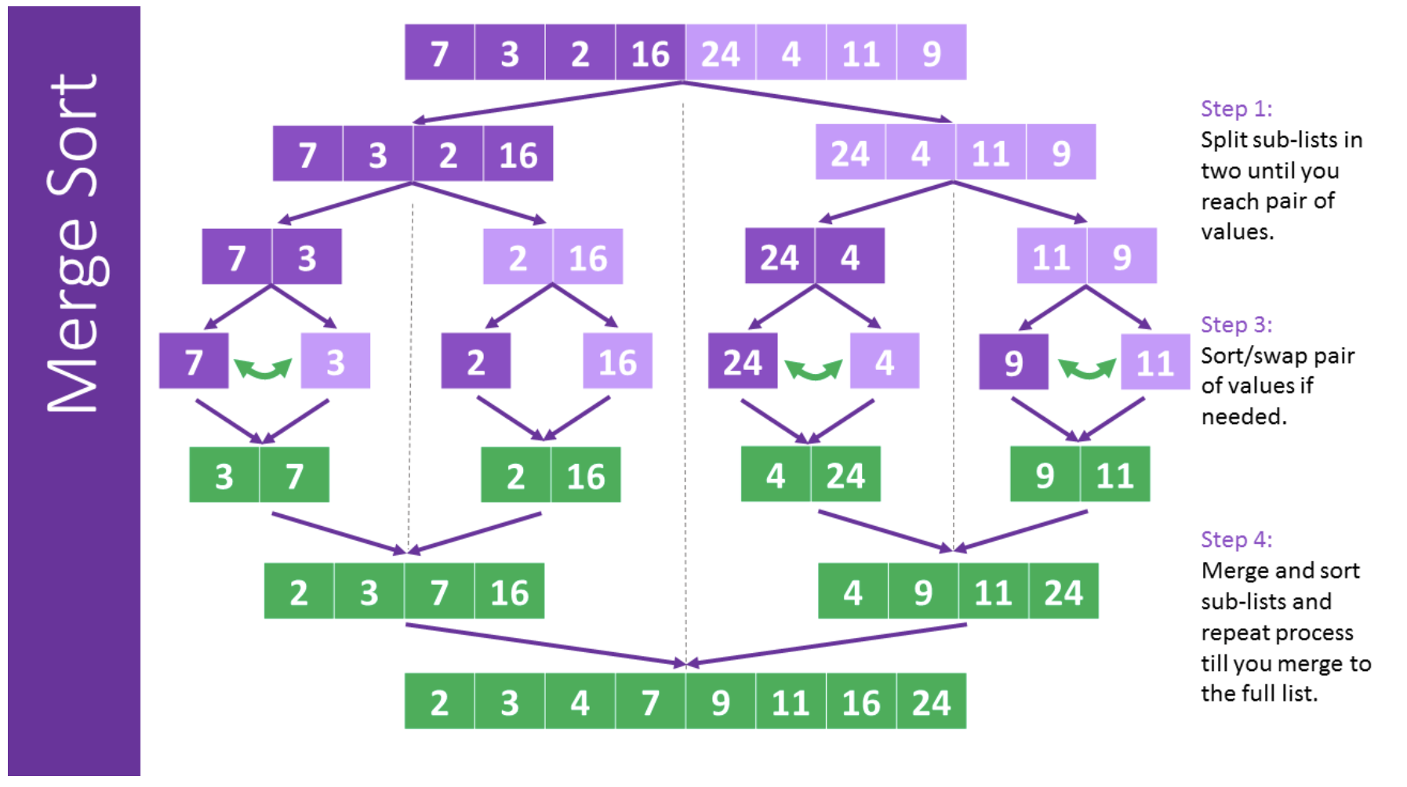
3. Merge Sorting Algorithm

Slide 10
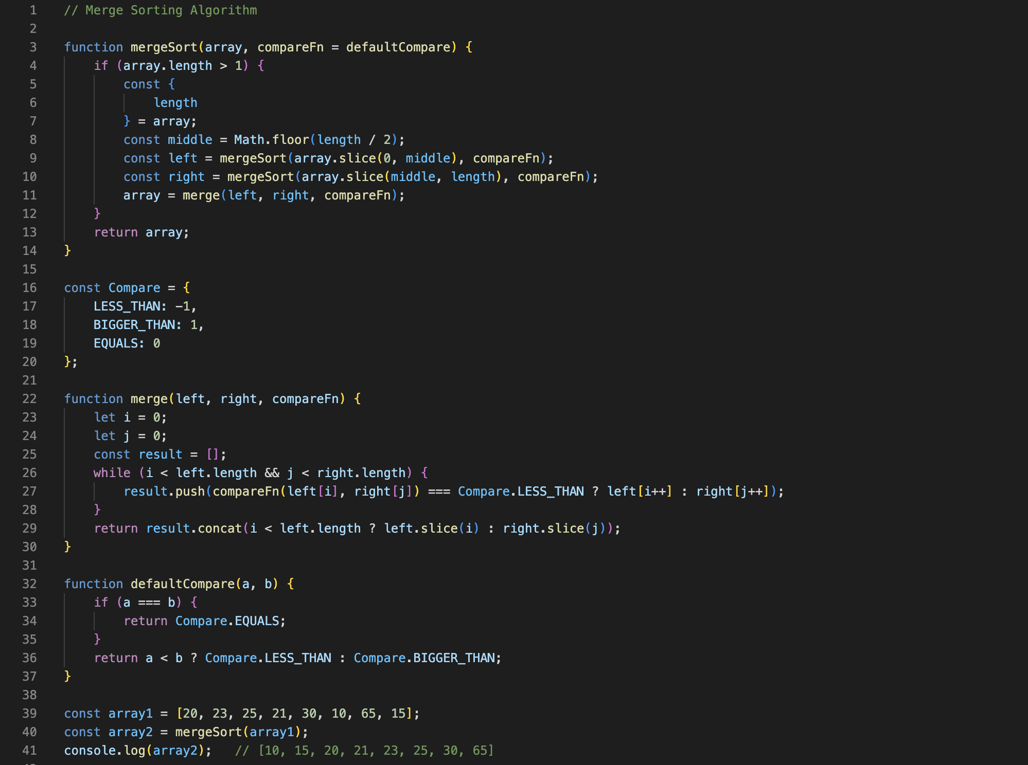

Slide 11
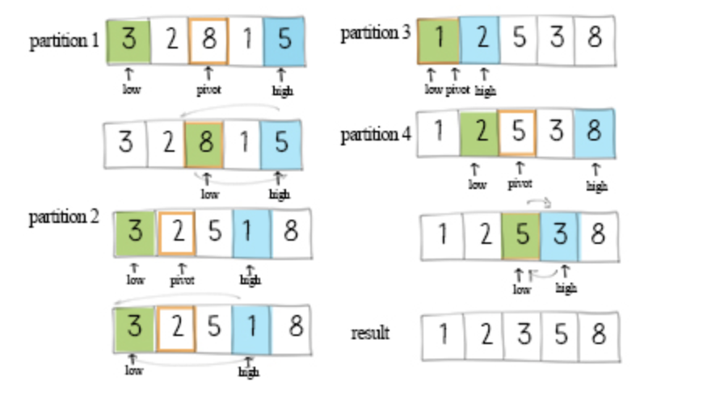
4. Quick Sort Algorithm

Slide 12
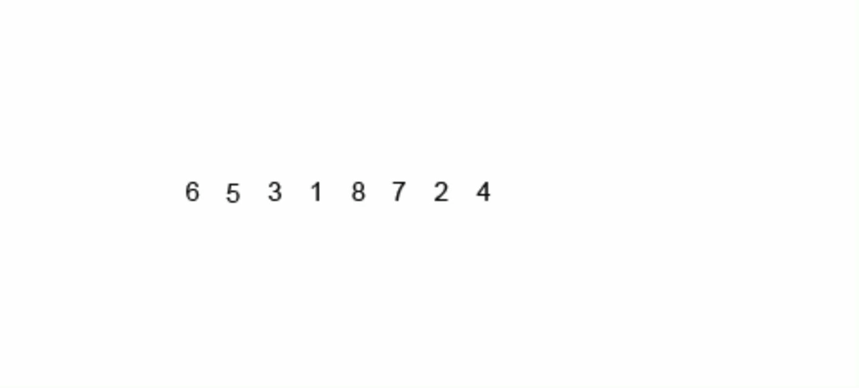
4. Quick Sort Algorithm

Slide 13
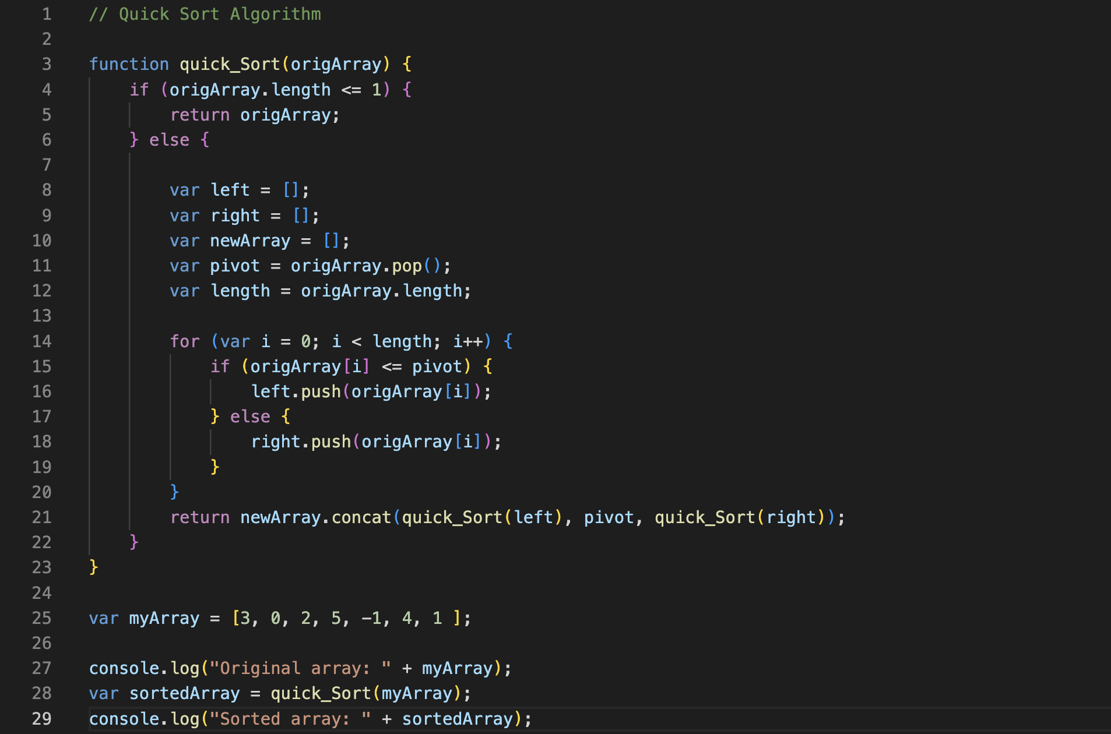

Slide 14
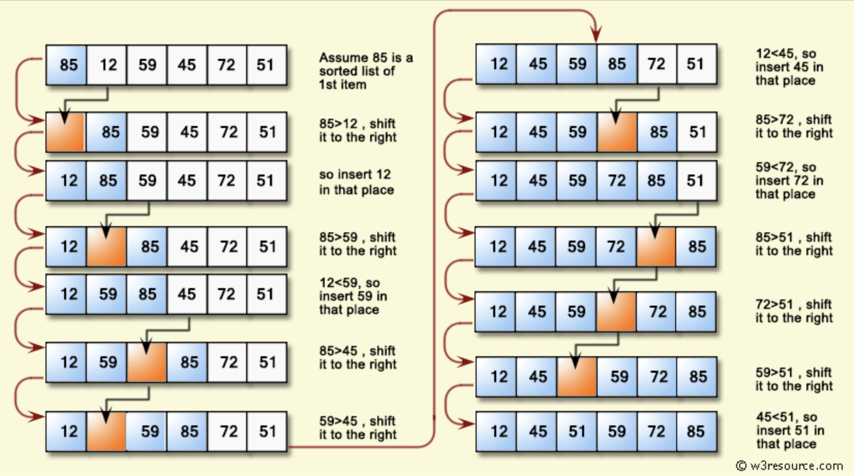
5. Insertion Sort Algorithm

Slide 15
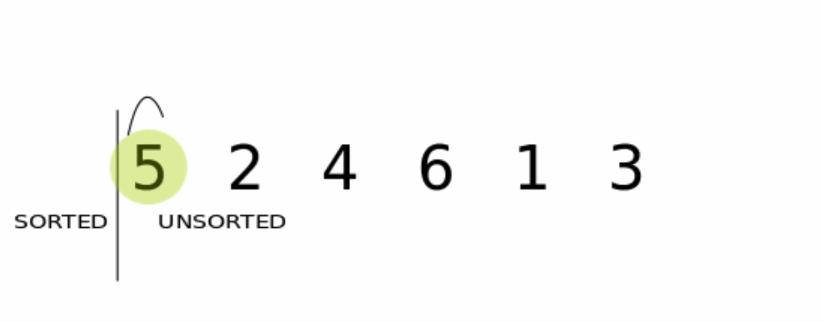
5. Insertion Sort Algorithm

Slide 16
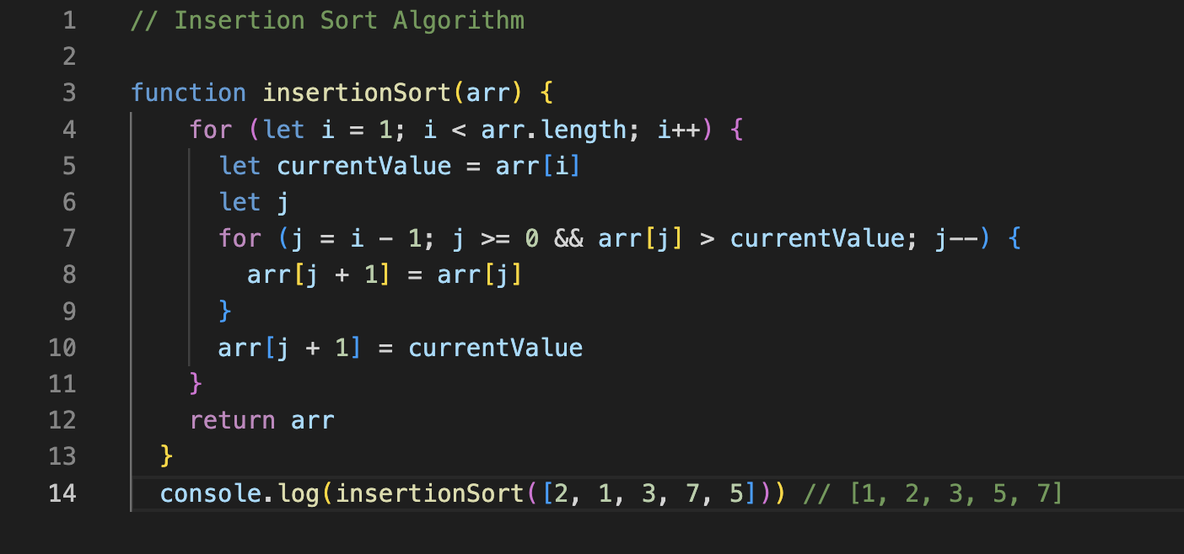

Slide 17
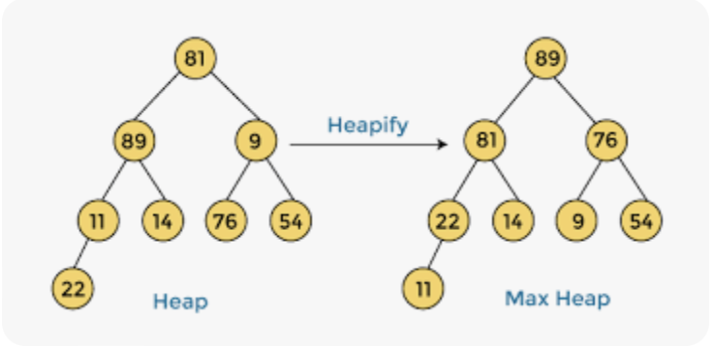
6. Heap Sort Algorithm
link

Slide 18
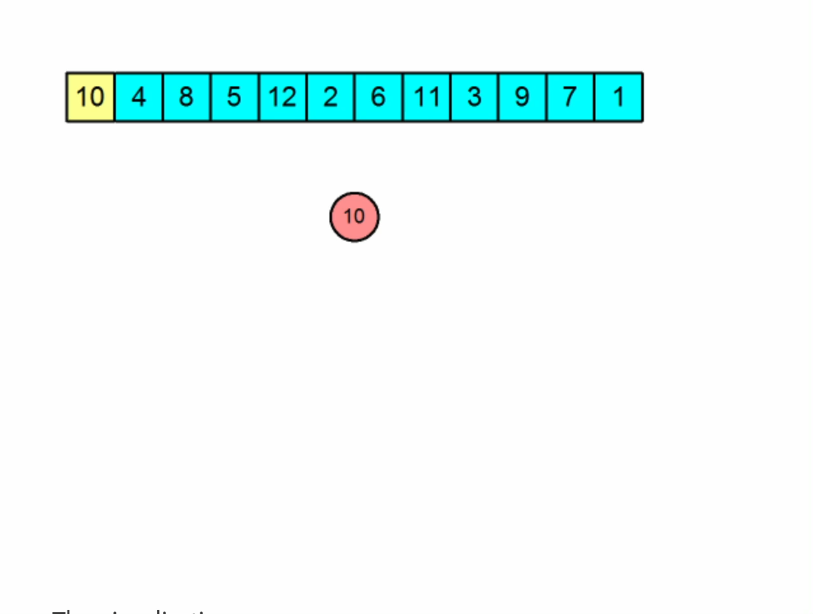
6. Heap Sort Algorithm

Slide 19
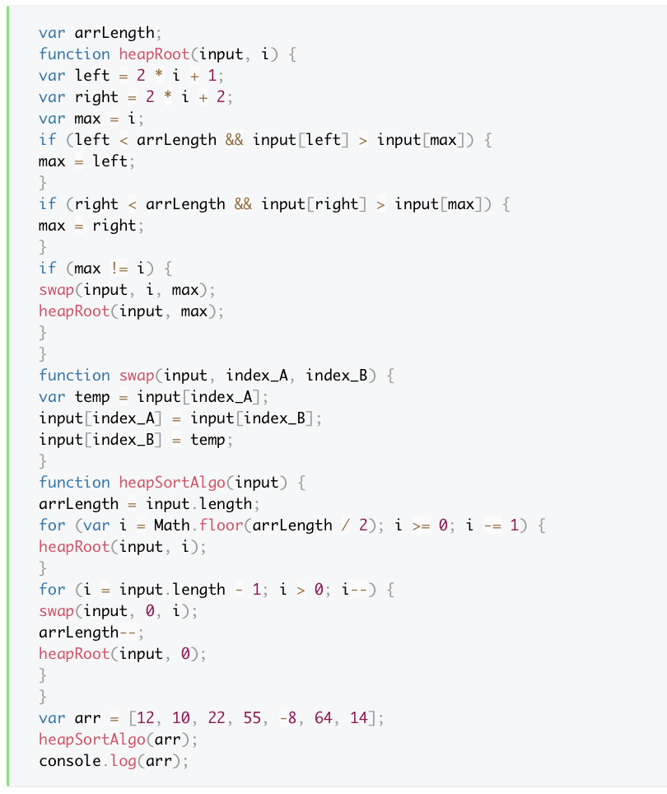
Code:

Slide 20
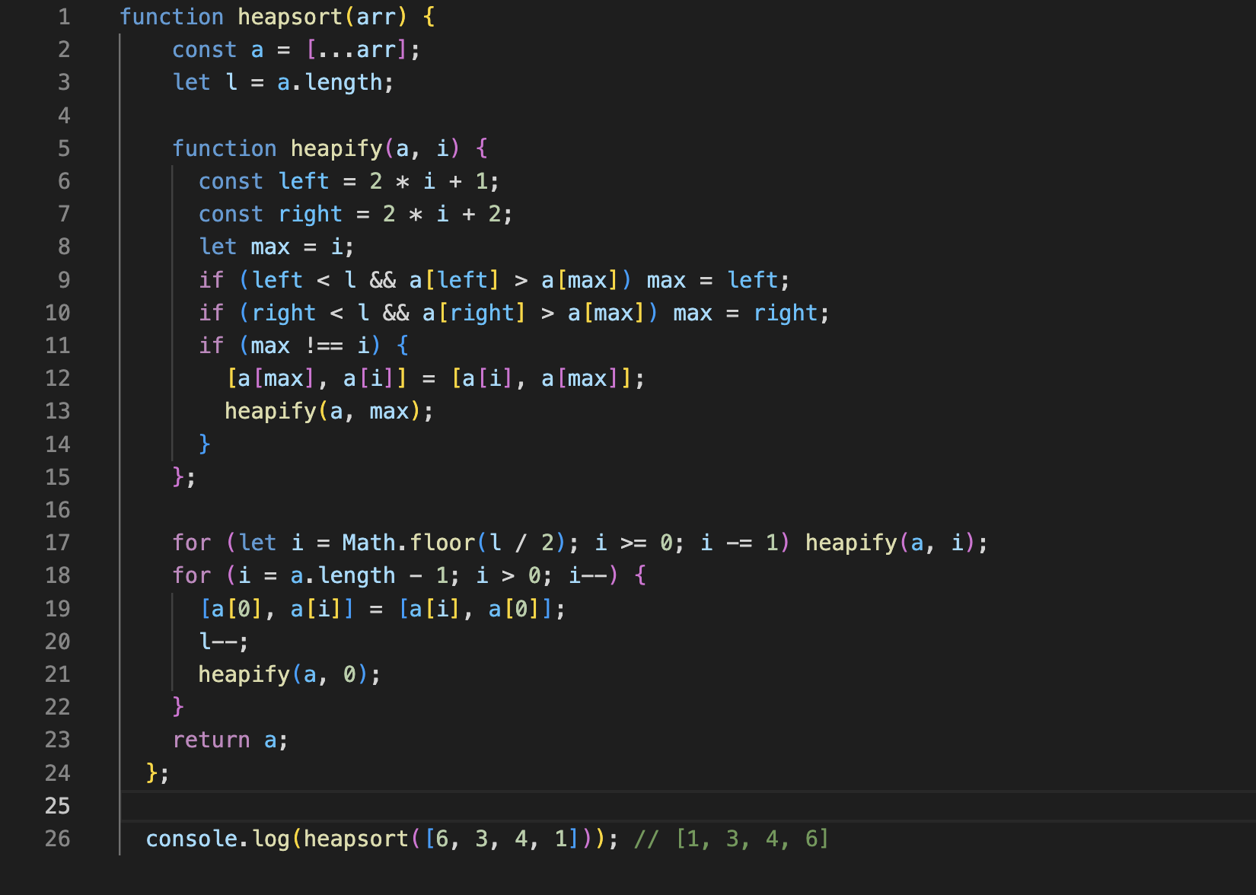

Slide 21
Additional information
Insertion Sort vs Bubble Sort + Some analysis
Merge Sort vs Quick Sort
Heaps and Heap Sort
Common Sorting Algorithms in JavaScript

